Slide 1



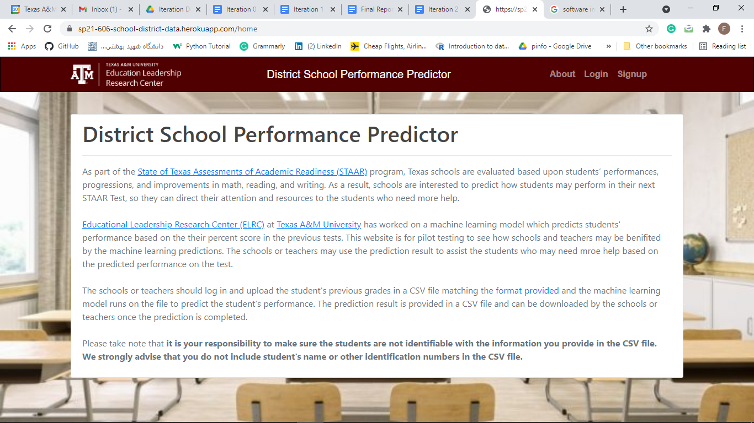
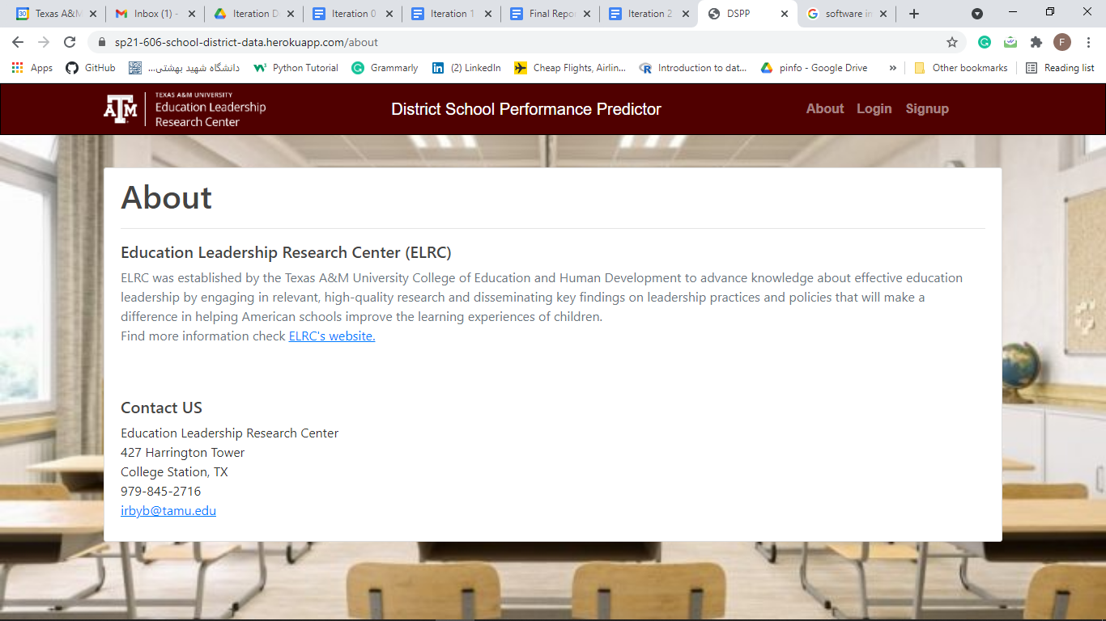
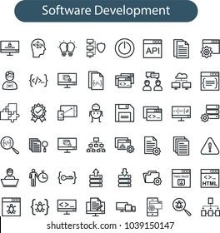

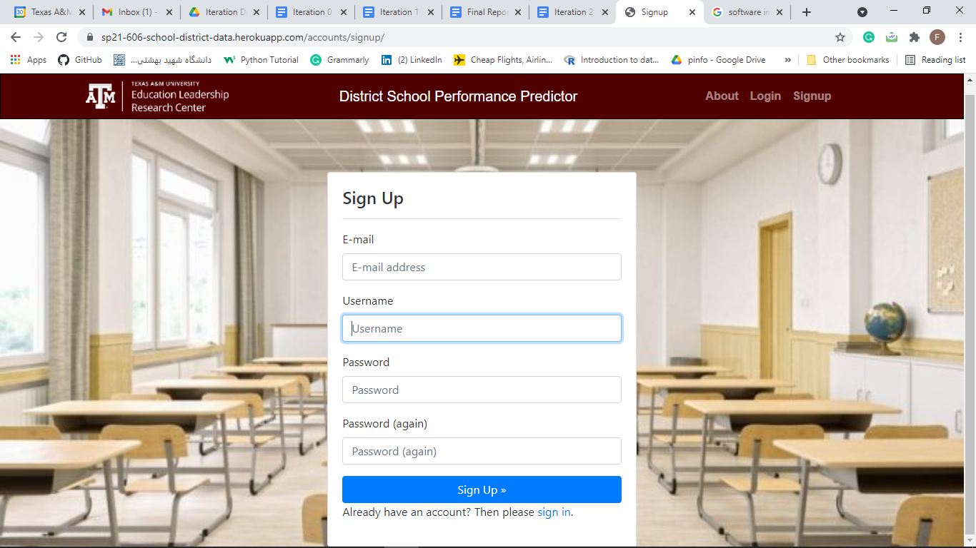
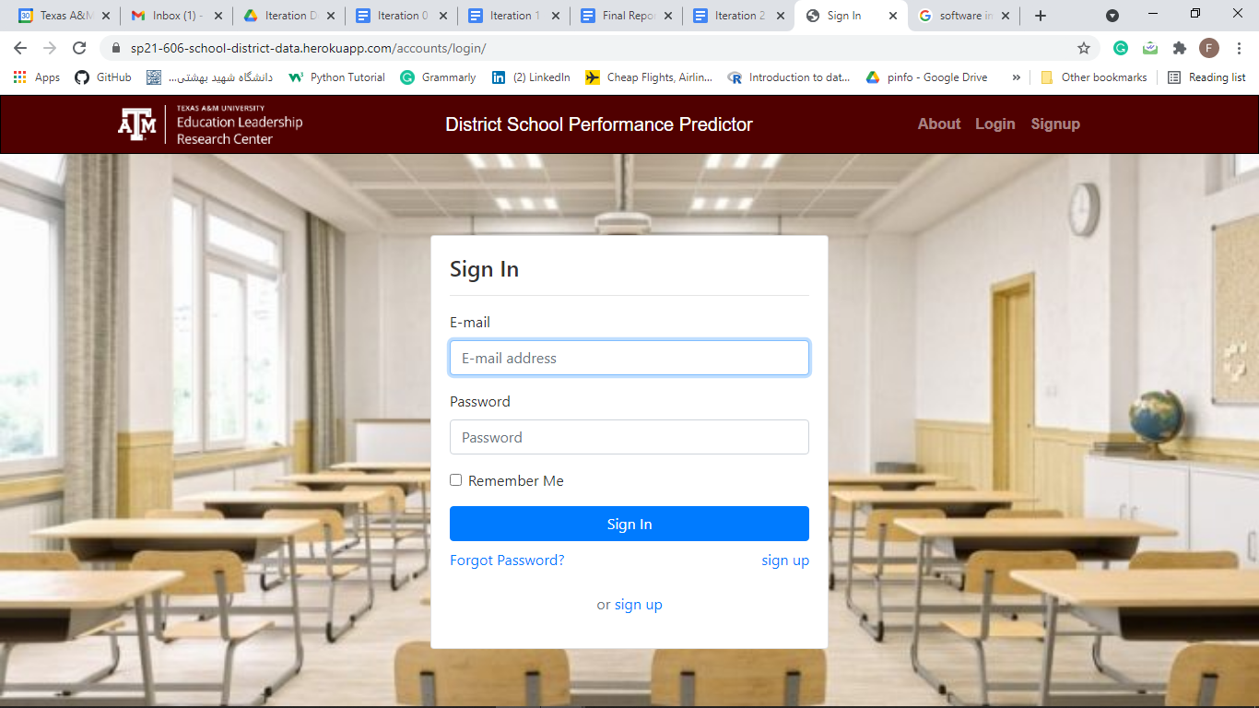
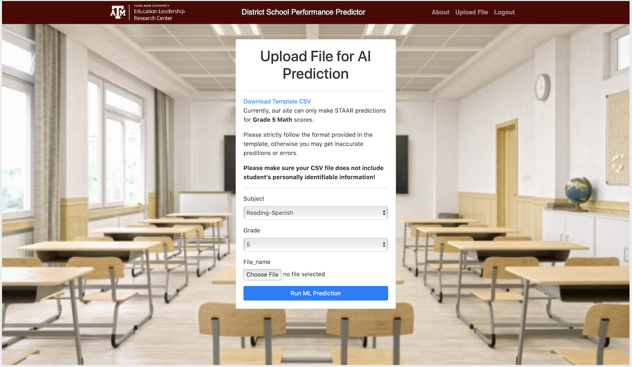
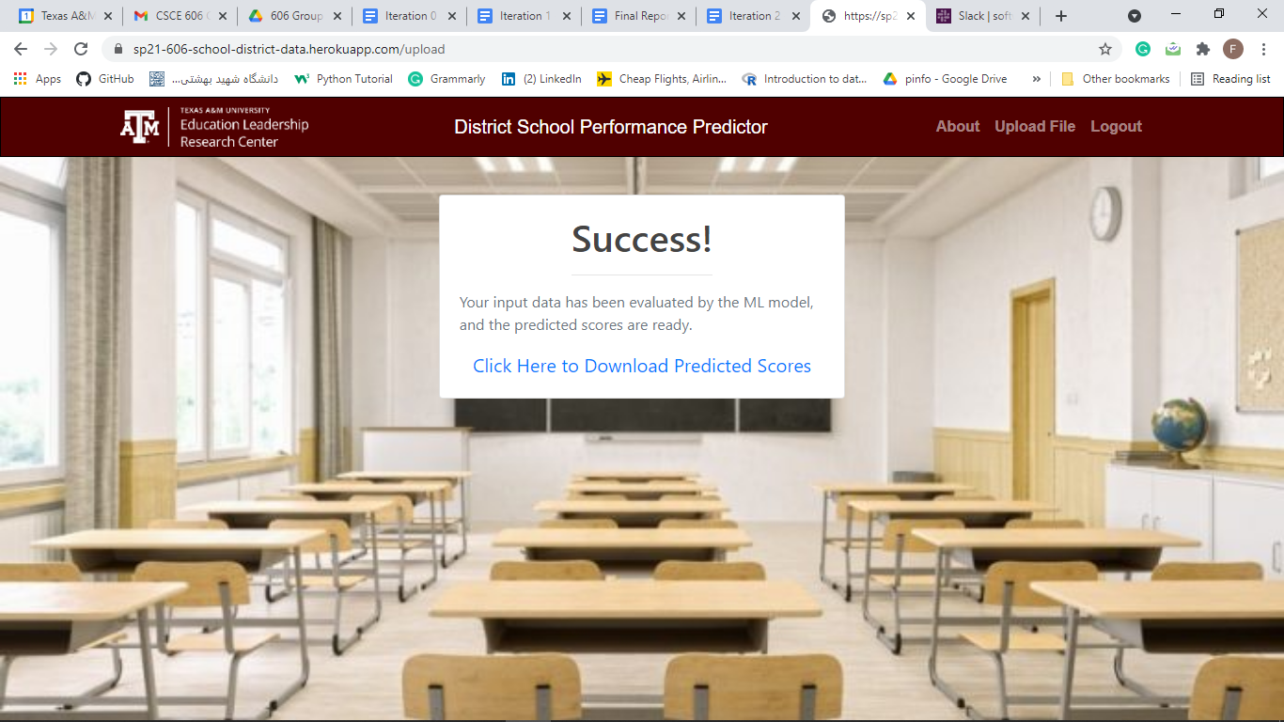
District School Performance Predictor
Hannah Patrick, Nathaniel Raggo, Mehdi Gorjian, Jason Spencer, Farnoosh Shirani Bidabadi, Alireza Safdari
Department of Computer Science and Engineering, Texas A&M University
Introduction
Legacy Code Refactoring
Texas schools are evaluated based on students’ performances, progressions, and improvements on the State of Texas Assessments of Academic Readiness (STAAR) Tests. As a result, schools are interested to predict students performance on their next STAAR Test. To assist the schools and teachers we have deployed Educational Leadership Research Center’s (stakeholder) machine learning model on a website to predict students’ performances.
After several days of troubleshooting the legacy user interface code during iteration 2, our team decided it was best to redesign the application. Therefore, we created a new application with a code organized by functionality, a better internal structure, and working defaults such as user authentication. Also, we re-designed user input forms, so they would now properly interact with the database, unlike the legacy code. We were then able to finalize our database with additional tables, fields, validations, and model relations such as teachers to files, a many-to-one relationship. Finally, we were able to add a new authentication system with easy to implement account administration features such as password reset via email. All of these features and new database objects were now accessible and able to be manipulated from the Django admin panel.
Agile Workflow
Iteration 1
Implement initial user stories
Minor code refactoring
Improve and additional testing
Iteration 3
Improved upload and admin pages
Integrate AI
Finalize and deploy it to Heroku
Application Flow
Homepage which includes a project overview and purpose.
About page which displays more information about the ELRC.
Iteration 0
Ideas for new application
Find requirements
Make user stories and user interfaces
Iteration 2
Major code redesign for user authentication
Updated new app view with legacy styles
Use of Django’s Test Case module
User Stories
Our User Sign-up form, necessary to use the service
Sign in page for users who have an account in the system.
As a teacher, I want to be able to log in, so that I can access the application under my profile (2 points)
As a teacher, I want my credentials to be remembered after I sign up, so that I can continue to use my same login information (2 points)
As a teacher, I want to be able to upload and download a CSV from the webpage, so that I can interact with the AI application (4 points total)
As a teacher, I want my file to be used by the AI prediction, so that I can receive predicted STAAR test scores (2 points)
As a stakeholder, I want the Home and About pages to contain our information, so that it will represent and explain the project (1 point)
As a teacher, I want to be able to download a CSV template, so that I can properly format my data for the AI prediction (1 point)
After the users log-in to the system they have access to the upload page. On this page users can upload a file and click on “run AI Prediction” to receive predictions.
This page shows that the data has been evaluated successfully and the user can download the result that is provided in a CSV file.
Testing and Verification
Tools
Conclusion
Unit and Integration tests written using Django’s TestCase
Tests serve to verify functionality and indicate if and where unexpected changes occurred in the code
Created a workflow in GitHub’s CI that automatically runs our tests and generates a coverage report when a pull request is created
GitHub CI: Used to define workflows to automate tasks. Setup inside GitHub, tests will run automatically on pull request.
Deepsource.io: Performs static analysis on code to find styling issues, anti-patterns, bug risks, etc. It integrates with GitHub and checks code quality concerns automatically on pull request.
GitUML: Generates a UML diagram for all, or selected parts, of a GitHub repository. It simplifies diagram creation process via automation.
Django’s Allauth: Set of applications for different authentication types and account management. It simplifies an application by omitting the need to write one’s own authentication code.
Python’s Coverage: Generates test coverage in an easy to read, HTML format.
Django’s Test Toosl: A suite of tools used to test code in Django. It can be used to write a variety of tests, including unit and acceptance tests.
We successfully created and delivered a website to the stakeholder in which teachers can upload their student’s grades and receive back a prediction of individual students’ standardized STAAR test scores.
As a team, we thoroughly documented our work enabling future teams to further develop this project.
We have deployed our final website on Heroku.
Challenges
Acknowledgements
Improving the legacy code was difficult due to its original design and coding in Django rather Ruby. Additionally, it was necessary to stay in communication with Team Thinksmart as they were advancing the AI used in this project.
We would like to thank Dr. Hank Walker, Shravani Sridhar, and our clients for providing us with clear requirements and clearing our doubts when ever needed.

